Slide 1
Heart Disease Prediction
&
Accuracy Comaprison
using
Neural Network, KNN, Logistic Regression, SVM and Random Forest

Slide 2
Team members and contribution:
Anshul Shrivastava(183310001)
Chetan Mahajan(19331003)
Aditi Sawant(193310008)
Rupak Bose(193310011)
Dharmendra Kumar(193310014)
The contribution of all teammates in the project was equal, we did work separately but had the colab file shared with each other.

Slide 3
Problem Statement:
Heart is the vital organ of human body, any problem in it reflects on other organs. So our aim is to develop a tool analyse a person has heart disease or not on basis of the given factors which are age,sex, cholesterol and more.
The dataset is taken from UCI. It has 303 instances and 14 attributes with some null values.
The dataset contains age,sex,chest pain, resting resting blood pressure, cholesterol, fasting blood sugar, resting ECG, maximum heart rate, exercise induced angina, oldpeak, slope, number of vessels colored and thalassemia. The final target or class has values 0,1,2,3 and 4. 0 signifies absence of disease and other show disease presence. For classification we have classified using Neural Networks considering total 5 classes and later on we converted the data to binary classification and implemented SVM, KNN, Logistic Regression.

Slide 4
Description of Dataset:
age : age of the person
sex : gender of person as 1 for male, 0 for female.
Chest pain type(cp) : type of chest-pain experienced by person as 1 = typical angina, 2 = atypical angina, 3 = non - anginal pain, 4 = asymptotic
Resting Blood Pressure(trestbps) : shows the resting blood pressure value of an individual in mmHg (unit)
Serum Cholesterol (chol) : shows serum cholesterol in mg/dl (unit)
Fasting Blood Sugar(fbs) : compares the fasting blood sugar value of an individual with 120 mg/dl. If fasting blood sugar > 120 mg/dl then : 1 (true) else : 0 (false)
Resting ECG(restecg) : 0 = normal 1 = having ST-T wave abnormality 2 = left ventricular hypertrophy
Max heart rate achieved (thalach) : displays the max heart rate achieved by an individual.
Exercise induced angina(exang) : 1 = yes 0 = no
ST depression induced by exercise relative to rest(oldpeak) : displays the value which is integer or float.
Peak exercise ST segment(slope) : 1 = upsloping 2 = flat 3 = downsloping
Number of major vessels (0-3) colored by fluoroscopy(ca) : displays the value as integer or float.
Thal : displays the thalassemia as 3 = normal 6 = fixed defect 7 = reversible defect
Diagnosis of heart disease(class/target) : Displays whether the individual is suffering from heart disease or not : 0 = absence 1,2,3,4 = present.

Slide 5
Facts:
CVDs are the number 1 cause of death globally: more people die annually from CVDs than from any other cause
An estimated 17.9 million people died from CVDs in 2016, representing 31% of all global deaths. Of these deaths, 85% are due to heart attack and stroke
Over three quarters of CVD deaths take place in low- and middle-income countries
Heart disease and stroke together contributed to 28·1% of total deaths in India in 2016

Slide 6
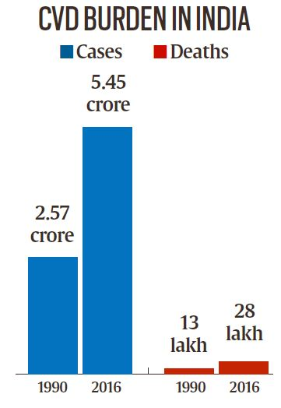
The adjacent figure shows, the number of people suffering from Cardiovascular Diseases(CVD), in India (as of 2016 and 1990) and the deaths due to CVD.
CVD is the leading cause of death in urban areas and rural areas too. The detection of any disease is complex and involves many factors to detect.
There is an important need for a helping tool to assist experts to diagnose disease and carrying out the analysis.
Source for figure: [Indian Express]

Slide 7
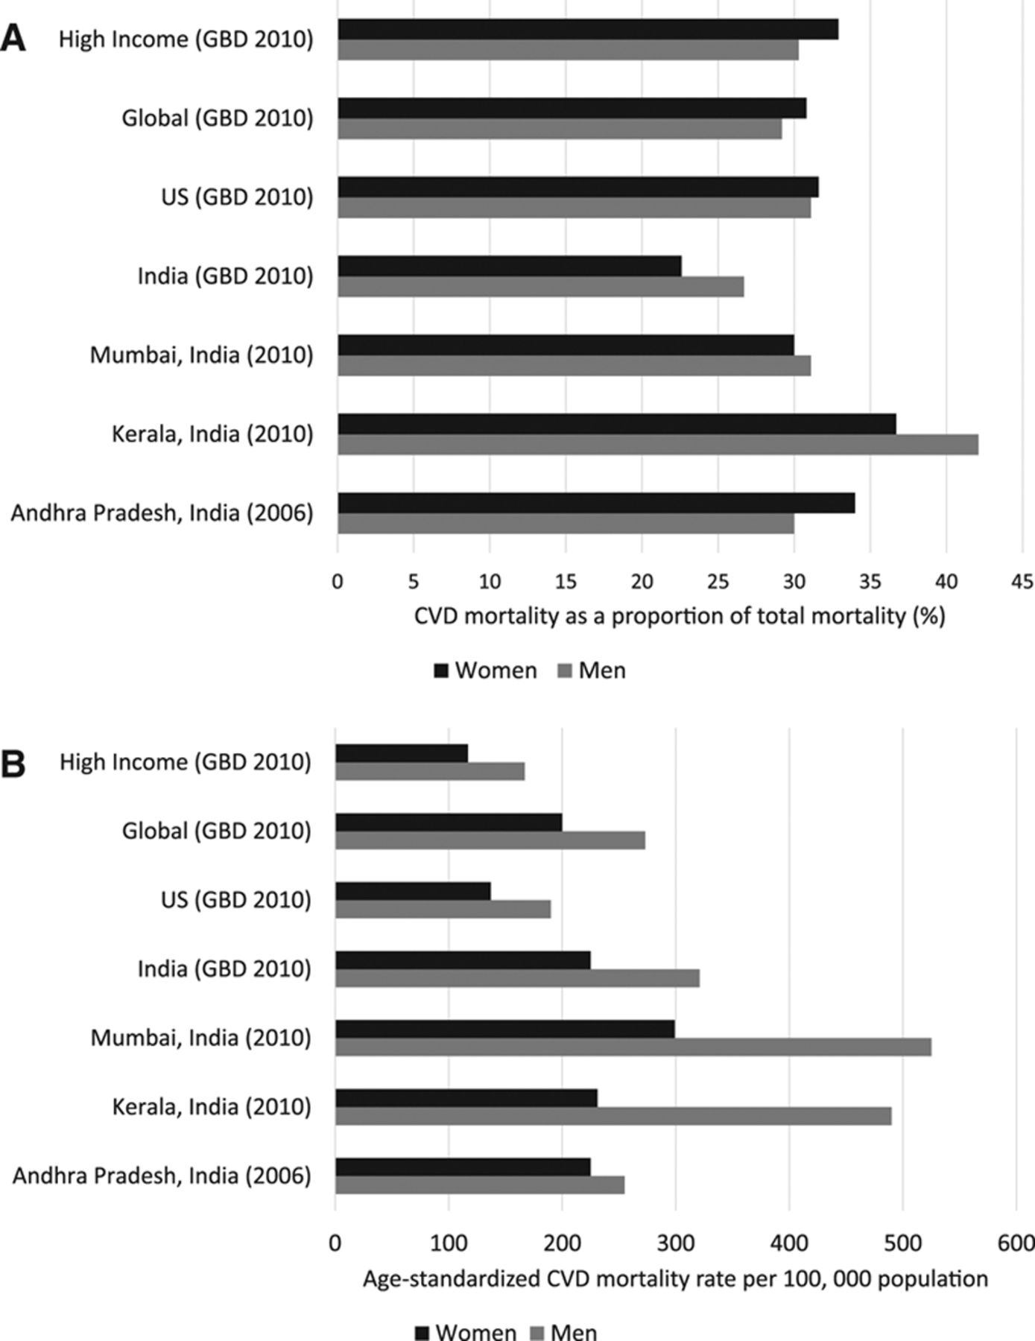
Figure 1. A, Proportion of cardiovascular disease mortality in India based on data from available prospective studies and Global Burden of Disease estimates.
Figure 1. B, Age-standardized rate of cardiovascular disease mortality in India based on Global Burden of Disease estimates and data from available prospective studies. CVD indicates cardiovascular disease; and GBD, Global Burden of Disease.
Source: ahaJournals

Slide 8
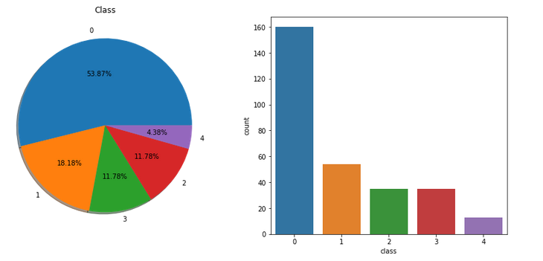
Pie Chart and Bar Plot to understand frequency for each class:

Slide 9
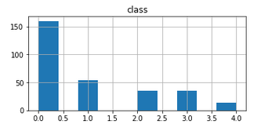
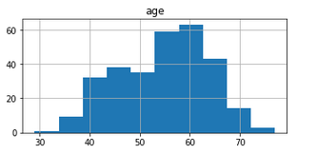
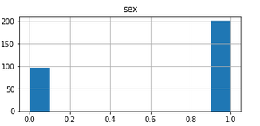
Histograms:
Gender vs class(disease category)
Number of person vs age
Sex/gender vs number of persons

Slide 10
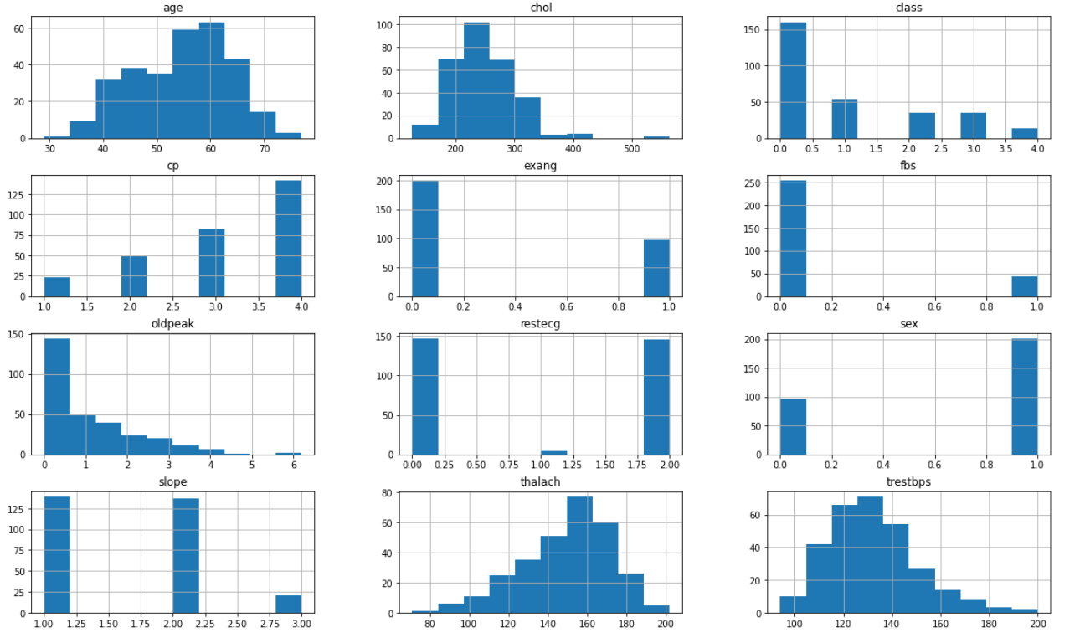
Various Histograms:(described in notebook)

Slide 11
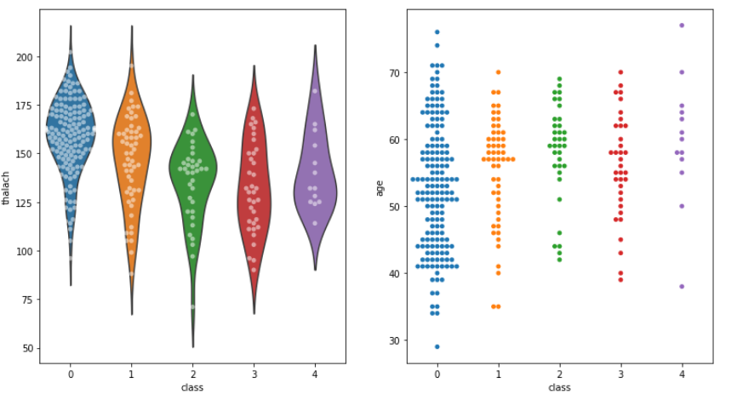
Swarm plot and violin plot for each class variation with thalassemia and age:

Slide 12
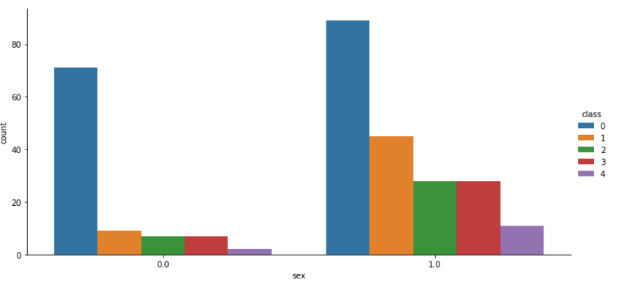
catplot between sex and distribution of target class frequency based on sex:

Slide 13
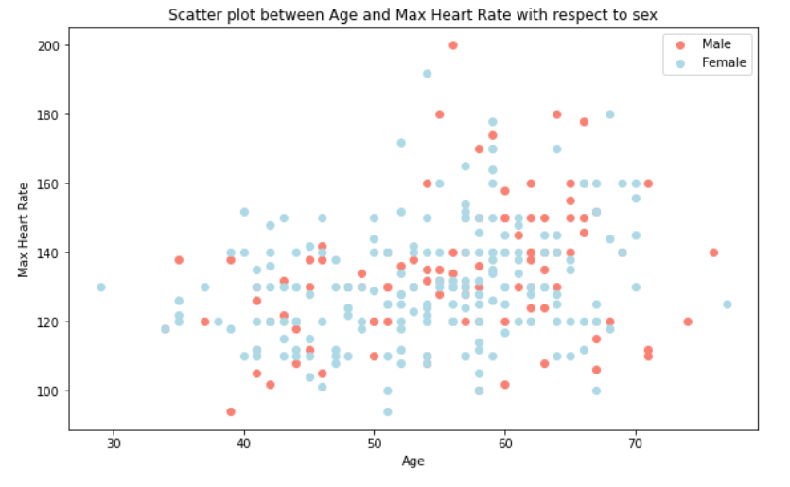
Scatter plot between Age and Maximum Heart rate with respect to sex:

Slide 14
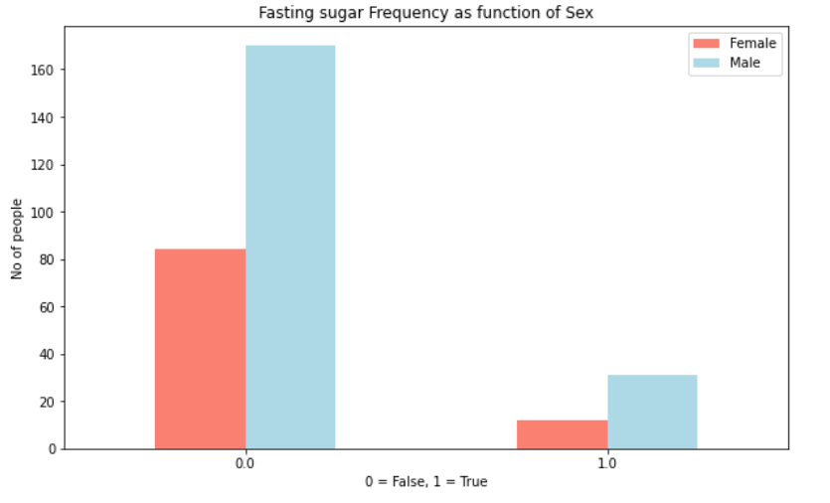
Distribution of Fasting sugar Frequency based on Gender:

Slide 15
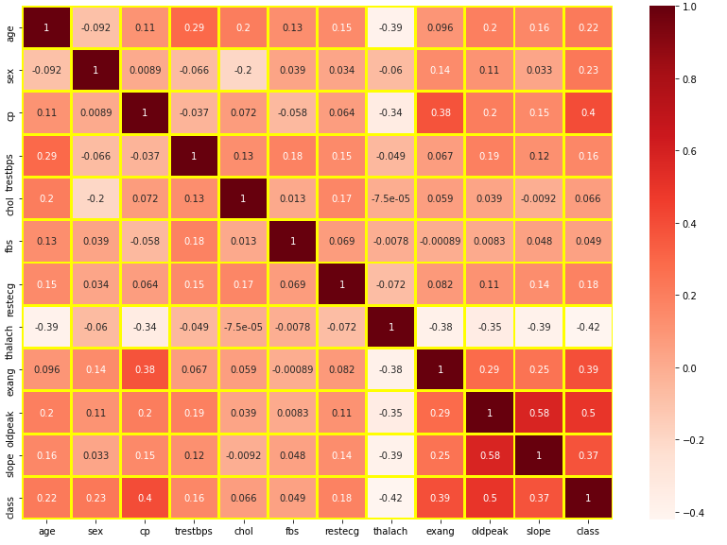
Correlation Matrix:

Slide 16
Following methods were adopted:
Data cleaning.
Implemented the following:
Neural Network as 5 classes
Neural Networks as 2 classes
KNN as 2 classes
Logistic Regression as 2 classes
SVM as 2 classes
Random Forest as 2 classes
Note: Data is required to be fetched online. We used random splitting so accuracy might change in different runs, analysis at last shows the average accuracy of 6 runs.

Slide 17
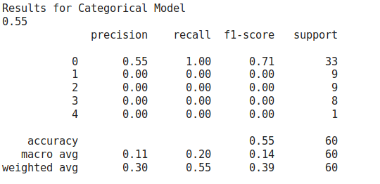
Neural Networks Result as multiclass(categorical):
Accuracy: 55%

Slide 18
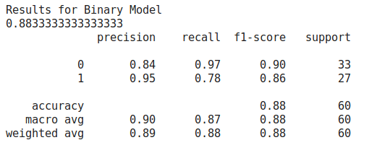
Neural Network as binary:
Accuracy : 88.3%

Slide 19
Observation between Neural Network Multiclass and Binary:
Incase of Neural Network Multiclass we got around 55% accuracy. We converted Neural Network Multiclass to Neural Network Binary class.
We get significant accuracy increase as we can see.
For this conversion, we just made two class, Heart Disease and No Heart Disease.
Person having Mild(1) to Severe heart disease(4) means person’s having heart disease hence we gave them “1” label that is having Heart Disease(1) and Person with class label as “0” remained same, that is person doesn’t has Heart Disease.

Slide 20
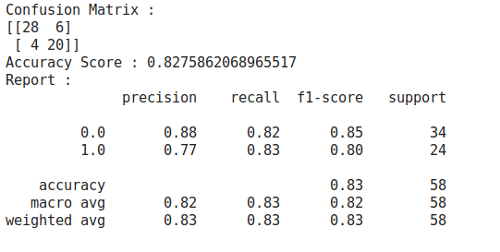
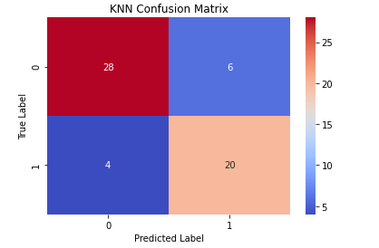
KNN:
Accuracy = 82.7%

Slide 21
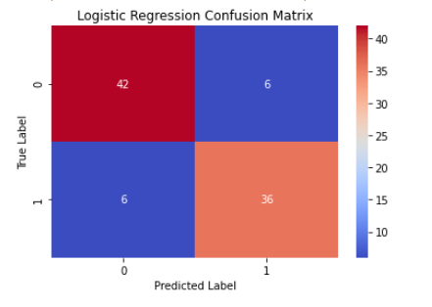
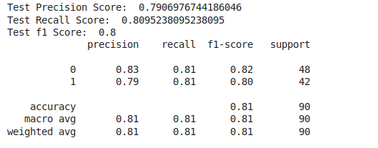
Logistic Regression:
Accuracy : 80.95%

Slide 22
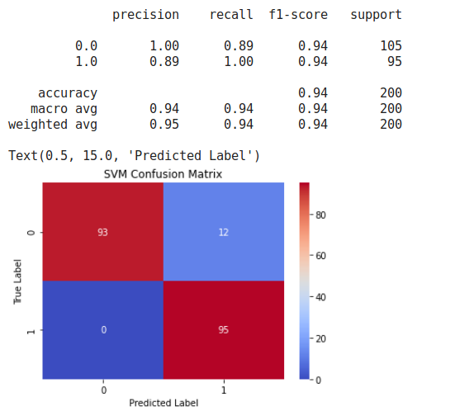
SVM Results:
Accuracy SVM=94%

Slide 23
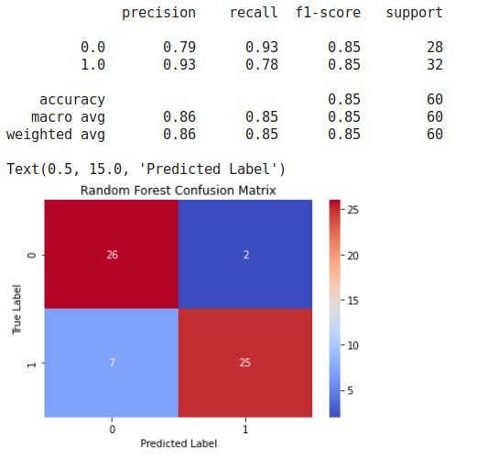
Random Forest:
Accuracy : 85%

Slide 24
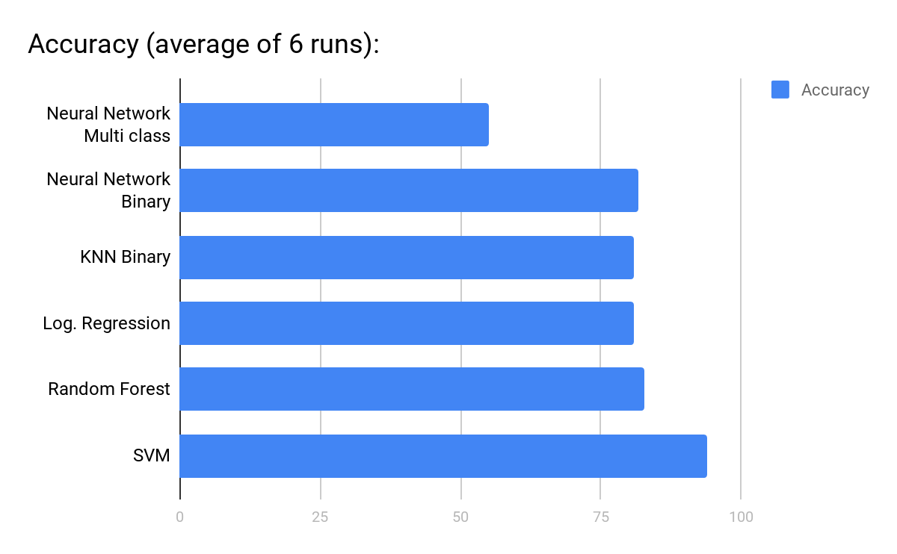
Analysis :
SVM performs best, than Random forest.
Others performance can be observed from graph.

